Slide 1
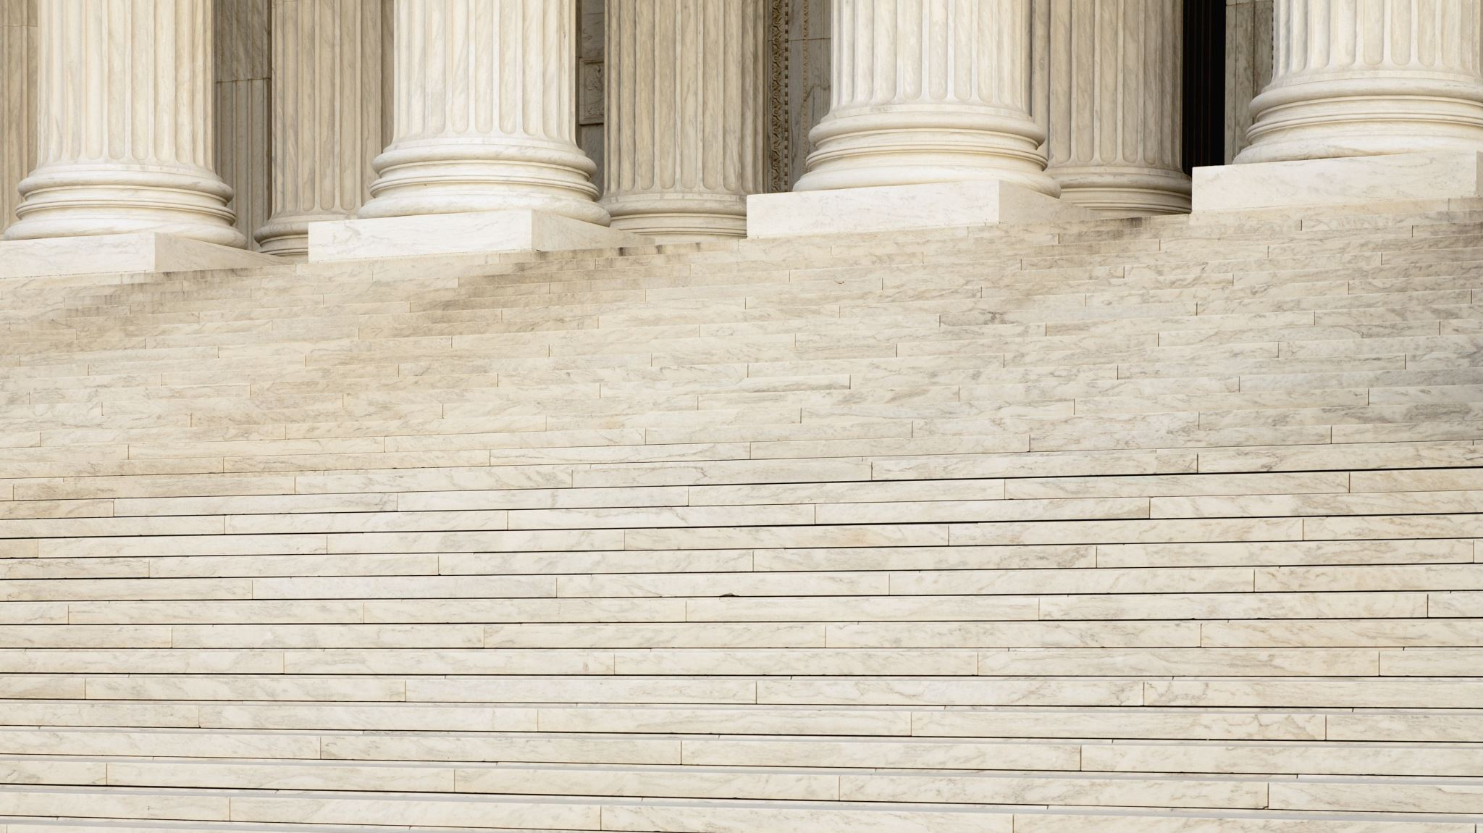
Stonewall
Student health & human services
Office of Human Relations, diversity & equity
July 2022

Slide 2
Welcome: Would you rather...
Be a mermaid/merman?
Be a centaur?

Slide 3
Objectives
Learn about the history of Stonewall
Identify the importance of this event
Learn about how this event has impacted the LGBTQ+ community today

Slide 4
How the Stonewall Riots Sparked A Movement in History
Notes:
Teacher, please play the video for the students (3:54)

Slide 5
The Roots of the Riots
In the 1950’s and 60’s homosexuality was illegal in the United States.
Members of the gay community were subject to violence and discrimination.
In New York City, members of the gay community took refuge at gay bars throughout the city.
The Stonewall in was one such place in New York City.

Slide 6
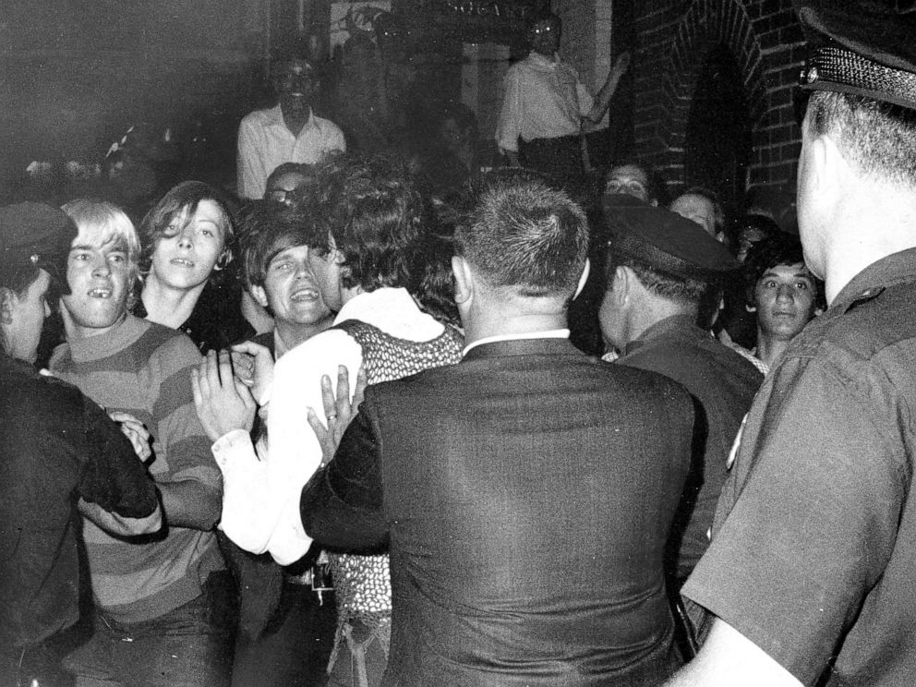
What is Stonewall?
The Stonewall in was owned by the mafia.
The Mafia blackmailed the wealth patrons, threatening to out them to their employers or families.
The police regularly raided the Stonewall Inn and other gay bars, charging them with solicitation of homosexual relations.
Meanwhile, trans and other gender nonconforming people were often arrested and charged with “non-gender appropriate clothing”

Slide 7
Reflection
We learned that homosexuality was illegal in the 1950’s and 60’s. Additionally, folks could be arrested for wearing “non-gender appropriate clothing”.
What are your thoughts about the government having that much control over how folks live their lives?
Are there any current laws that feel that oppressive to you?

Slide 8
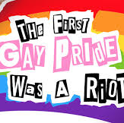
After Stonewall
After the Stonewall riots, gay men and lesbians in New York City faced gender, race, class, and generational obstacles to becoming a cohesive community.
Within six months, two gay activist organizations were formed in New York, concentrating on confrontational tactics, and three newspapers were established to promote rights for gay men and lesbians.
A year after the uprising, to mark the anniversary on June 28, 1970, the first gay pride marches took place in New York, Los Angeles, and San Francisco.

Slide 9
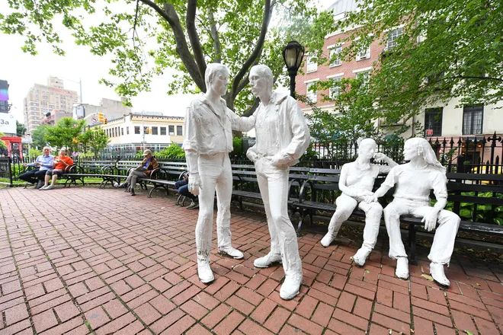
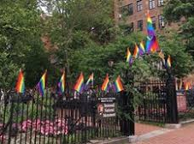
After Stonewall
The anniversary of the riots was also commemorated in Chicago and similar marches were organized in other cities.
Within a few years, gay rights organizations were founded across the U.S. and the world.
The was Stonewall National Monument established at the site of the riots in 2016.

Slide 10
What are some rights the LGBTQ+ community has gained recently?
Do you think there are still more rights that LGBTQ+ people should have?
If so, what rights? What would need to happen to get those rights?

Slide 11
Check Out
Did you know about the Stonewall Riots before this presentation?
What was the most important thing you learned about Stonewall?
Has this changed your thinking about LGBTQ+ rights?

Slide 12
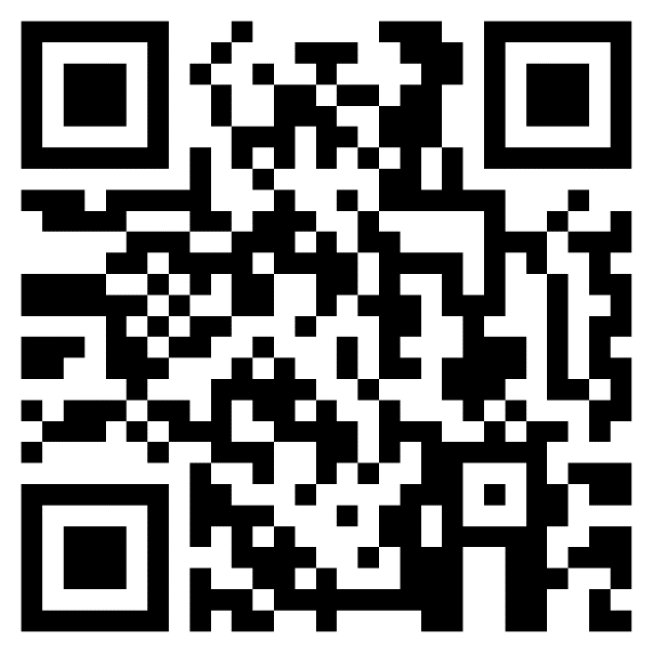
Teacher Feedback
Notes:
Teacher, please complete the brief feedback survey by scanning the QR code or using the link below.
https://forms.office.com/r/i9UqyyxzTT

Slide 13
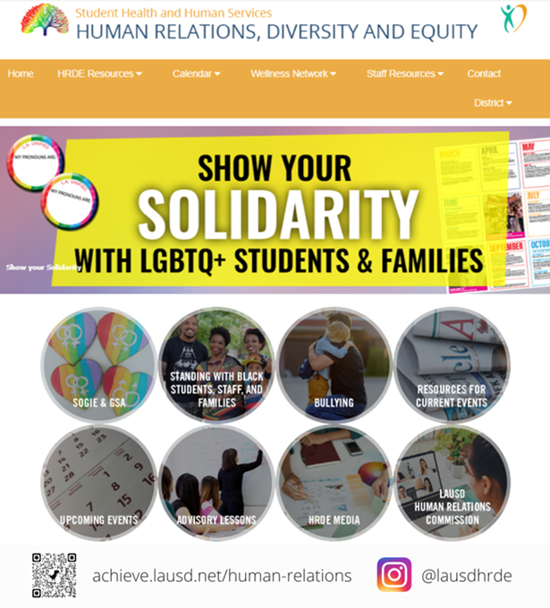
Human Relations, Diversity & Equity

